Slide 1

E-COMMERCE DATABASE Najah, Pragathi, Sagar, Mehak, Hrithik
DATABASE FOUNDATIONS
GROUP – 10

Slide 2

INTRODUCTION
1
INTRODUCTION
E-commerce is a rapidly growing industry that has transformed the way people buy and sell goods and services.
2
CHALLENGE
E-commerce faces challenges such as competition, security concerns, and customer trust, among others.
3
SOLUTION
To overcome e-commerce challenges, businesses can implement strategies such as offering personalized experiences, enhancing website security, and leveraging data analytics.
4
DATASET FEATURES
5 Entities, along with more than 5 attributes in each.

Slide 3
OBJECTIVE AND CHALLENGES
DATABASE SYSTEMS
DATA REDUNDANCY
There can be data be data redundancy problems in case the interface connected to the database does not know how to write new records or update records in the right table
The objective of this project is to design, develop, test, and implement a new e-commerce database system
KEY REQUIREMENTS
CONSTANT CHANGES
Ability to store and manage large amounts of product data and inventory information.
Capability to process and track online orders in real-time
With changes over time that might be new attributes that we need to take in consideration but are not currently present.

Slide 4

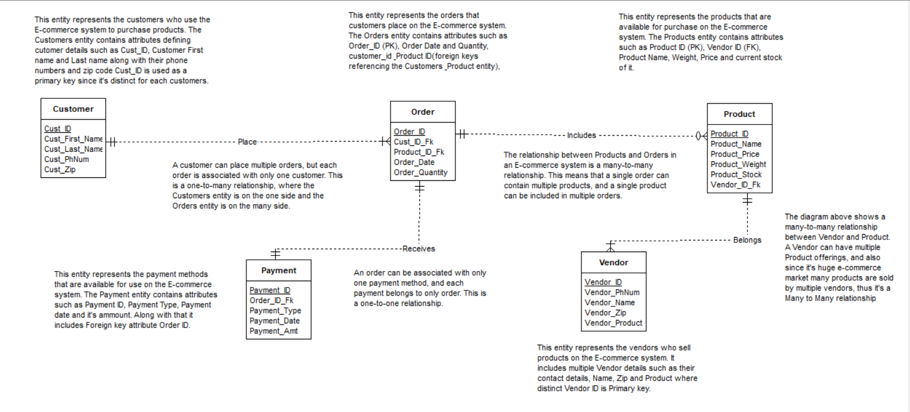
ERD DIAGRAM

Slide 5

TRIGGER AND SEQUENCES
Auto generation of Cust_Id, Vendor_Id, Order_Id, Product_Id, Payment_Id with below format: Creating Sequence: CREATE SEQUENCE Seq_Cust_ID START WITH 1 INCREMENT BY 1 MINVALUE 1 NOMAXVALUE;
Creating Trigger: CREATE OR REPLACE TRIGGER TR_CUST BEFORE INSERT OR UPDATE ON CUSTOMER FOR EACH ROW BEGIN :NEW.CUST_ID :=SEQ_Cust_ID.nextval; END ;

Slide 6

TRIGGER AND SEQUENCES
Auto generation of Payment_Date and Order_Date in below format: Creating Sequence: CREATE SEQUENCE Seq_Order_Date START WITH 1;
Creating Trigger: CREATE OR REPLACE TRIGGER TR_ORDER_DATE BEFORE INSERT OR UPDATE ON PURCHASE_ORDER FOR EACH ROW BEGIN :NEW.ORDER_ID := Seq_Order_Date.NEXTVAL; :NEW.ORDER_DATE := SYSDATE; END;

Slide 7

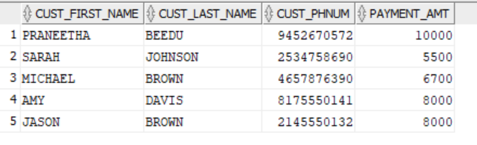
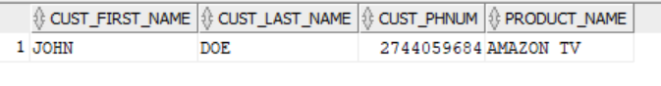
ADVANCED QUERIES
1) List Customer Information where the Payment Amount for product is greater than 5000
SELECT C.CUST_FIRST_NAME, C.CUST_LAST_NAME, C.CUST_PHNUM, P.PAYMENT_AMT
From CUSTOMER C
JOIN PURCHASE_ORDER O ON C.CUST_ID = O.CUST_ID
JOIN PAYMENT P ON P.ORDER_ID = O.ORDER_ID
WHERE PAYMENT_AMT > 5000;
2) List Customer First Name, Last Name, Phone number who ordered product Amazon TV
SELECT DISTINCT C.CUST_FIRST_NAME, C.CUST_LAST_NAME,C.CUST_PHNUM,P.PRODUCT_NAME FROM CUSTOMER C
JOIN PURCHASE_ORDER O ON O.CUST_ID = C.CUST_ID
JOIN PRODUCT P ON P.PRODUCT_ID = O.PRODUCT_ID
WHERE PRODUCT_NAME = 'AMAZON TV';

Slide 8

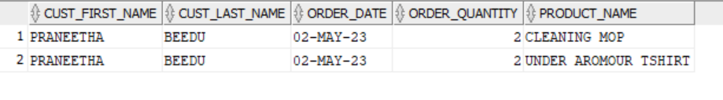
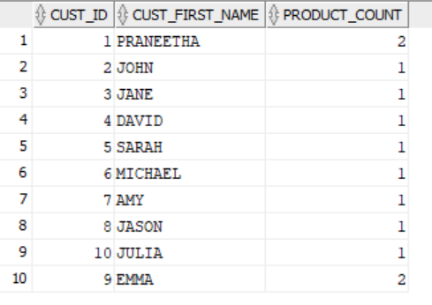
ADVANCED QUERIES
3) Display Customer name, order date, order quantity and product ordered where the customer zip = 75252
SELECT C.CUST_FIRST_NAME, C.CUST_LAST_NAME, O.ORDER_DATE, O.ORDER_QUANTITY, P.PRODUCT_NAME FROM CUSTOMER C
INNER JOIN PURCHASE_ORDER O ON C.CUST_ID = O.CUST_ID
INNER JOIN PRODUCT P ON O.PRODUCT_ID = P.PRODUCT_ID
WHERE C.CUST_ZIP = '75252';
4) Display Customer ID, Customer Name and their product counts
SELECT C.CUST_ID, C.CUST_FIRST_NAME, COUNT(P.PRODUCT_ID) AS PRODUCT_COUNT FROM CUSTOMER C
LEFT JOIN PURCHASE_ORDER O ON C.CUST_ID = O.CUST_ID
LEFT JOIN PRODUCT P ON O.PRODUCT_ID = P.PRODUCT_ID
GROUP BY C.CUST_ID, C.CUST_FIRST_NAME;

Slide 9
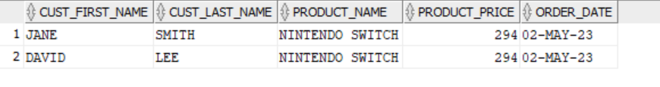
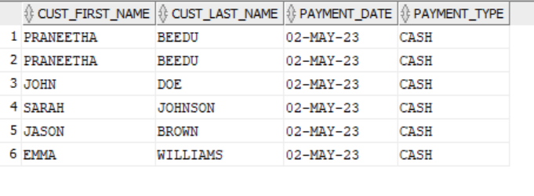
ADVANCED QUERIES
5) Display the names of Customers and products who ordered product with maximum product price
SELECT C.CUST_FIRST_NAME, C.CUST_LAST_NAME, P.PRODUCT_NAME, P.PRODUCT_PRICE, O.ORDER_DATE FROM CUSTOMER C
JOIN PURCHASE_ORDER O ON C.CUST_ID = O.CUST_ID
JOIN PRODUCT P ON P.PRODUCT_ID = O.PRODUCT_ID
WHERE P.PRODUCT_PRICE = (SELECT MAX (PRODUCT_PRICE)FROM PRODUCT );
6) Display names of customers and payment date who has payment type as CASH
SELECT C.CUST_FIRST_NAME, C.CUST_LAST_NAME, PY.PAYMENT_DATE, PY.PAYMENT_TYPE FROM CUSTOMER C
JOIN PURCHASE_ORDER O ON C.CUST_ID = O.CUST_ID
JOIN PAYMENT PY ON PY.ORDER_ID = O.ORDER_ID
WHERE PY.PAYMENT_TYPE = 'CASH';

Slide 10
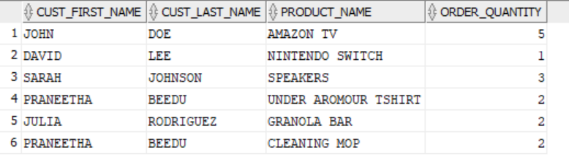
ADVANCED QUERIES
7) Display vendor and product details where order is placed by Customer - Praneetha Beedu
SELECT C.CUST_FIRST_NAME, C.CUST_LAST_NAME, O.ORDER_DATE, P.PRODUCT_NAME, V.VENDOR_NAME, V.VENDOR_ZIP, V.VENDOR_PHNUM FROM CUSTOMER C
JOIN PURCHASE_ORDER O ON O.CUST_ID = C.CUST_ID
JOIN PRODUCT P ON P.PRODUCT_ID = O.PRODUCT_ID
JOIN VENDOR V ON V.VENDOR_ID = P.VENDOR_ID
WHERE CUST_FIRST_NAME = 'PRANEETHA' AND CUST_LAST_NAME = 'BEEDU';
8) Display customer and payment details where the order quantity is between 1 and 5
SELECT C.CUST_FIRST_NAME, C.CUST_LAST_NAME, P.PRODUCT_NAME, O.ORDER_QUANTITY FROM CUSTOMER C
JOIN PURCHASE_ORDER O ON O.CUST_ID = C.CUST_ID
JOIN PRODUCT P ON P.PRODUCT_ID = O.PRODUCT_ID
WHERE O.ORDER_QUANTITY BETWEEN '1' AND '5';

Slide 11

THANK YOU

